Slide 1
Brain Tumor Detection
(Using Convolutional Neural Network)
CSET210, Milestone-3, B-38, G-10

Slide 2
Team Members of Group-3
Member 1:
Rittika Jana
E23CSEU1136
E23CSEU1136@bennett.edu.in
Member 2:
Jyotiman Dixit
E23CSEU1114
E23CSEU1114@bennett.edu.in

Slide 3
Introduction
Now a day's tumor is second leading cause of cancer. The medical field needs fast, automated, efficient and reliable technique to detect tumor like brain tumor. If proper detection of tumor is possible then doctors keep a patient out of danger. Using this application doctors provide proper treatment and save a number of tumor patients. A tumor is nothing but excess cells growing in an uncontrolled manner. Brain tumor cells grow in a way that they eventually take up all the nutrients meant for the healthy cells and issues, which results in brain failure. Our main target will be (firstly) to analyse and preprocessing the image dataset then build a Deep Learning Model (CNN) to check the training and validation accuracy. We took a dataset where grayscaling is already done. Advanced ML or Deep learning models can give higher accuracy leading to accurate detection of tumors , diseases etc. By time, updation of programs, patterns and higher power GPU will be able to implement more efficient model architectures.

Slide 4
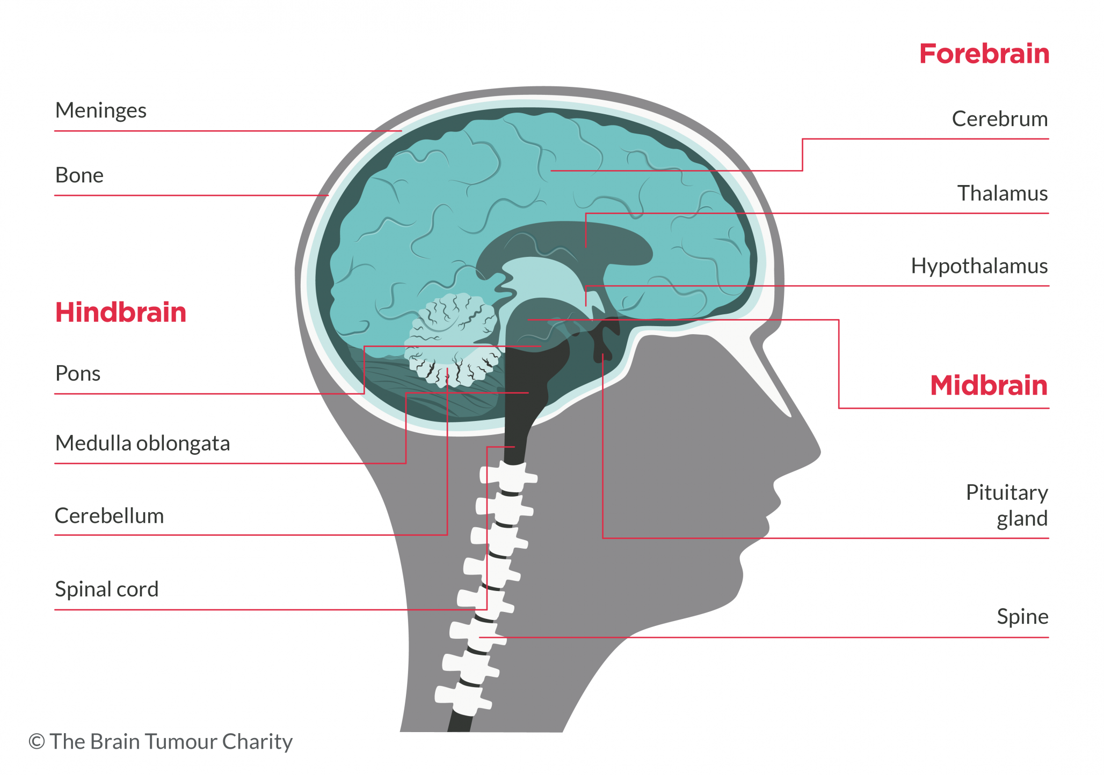
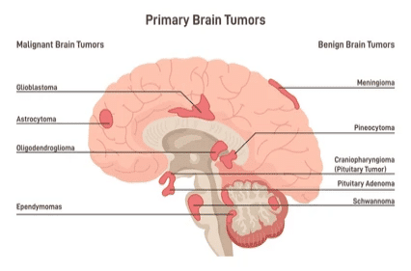
Anatomy of Brain

Slide 5
Methods of Detection
Clinical Evaluation (headaches, seizures, vision or hearing loss, balance problem etc.)
Imaging Techniques (MRI, CT Scan etc.)
Biopsy (taking a sample of the tumor tissue for lab testing….)

Slide 6
Data Collection
The image dataset was taken from Kaggle.
Here is the link:
https://www.kaggle.com/datasets/navoneel/brain-mri-images-for-brain-tumor-detection

Slide 7
Required Resources
According to our information, people who are involved in this topic generally use Python, R, Matlab, Power BI etc. The code editors are generally VS code, Jupyter notebook, Spyder, Colab (beginner friendly) etc.We will do this in Python. Packages are going to be PIL/Pillow, OpenCV, Sklearn, Numpy, tensorflow, keras , panda, matplotlib, seaborn. With these we will do Data Ingestion, a bit of processing if required, Model Architecture, accuracy checking , output, plotting graphs etc.
For hardware, minimum 16 GB RAM, Efficient GPU(RTX/144Hz), minimum 256 GB SSD , atleast an i5 processor of the latest generation is necessary.

Slide 8
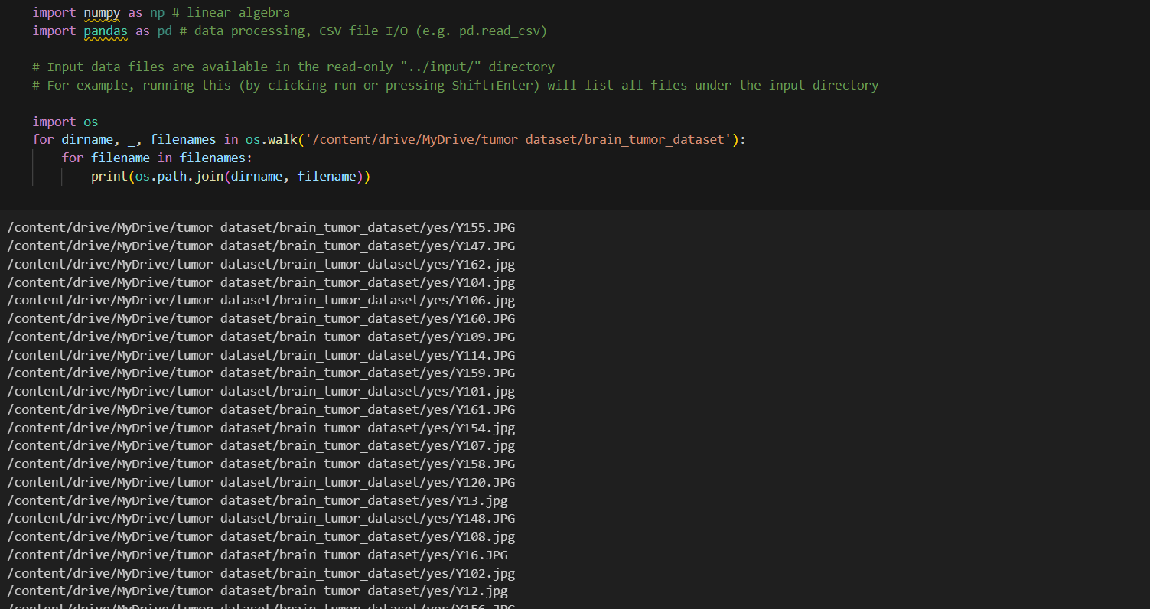
Some Outcomes:

Slide 9
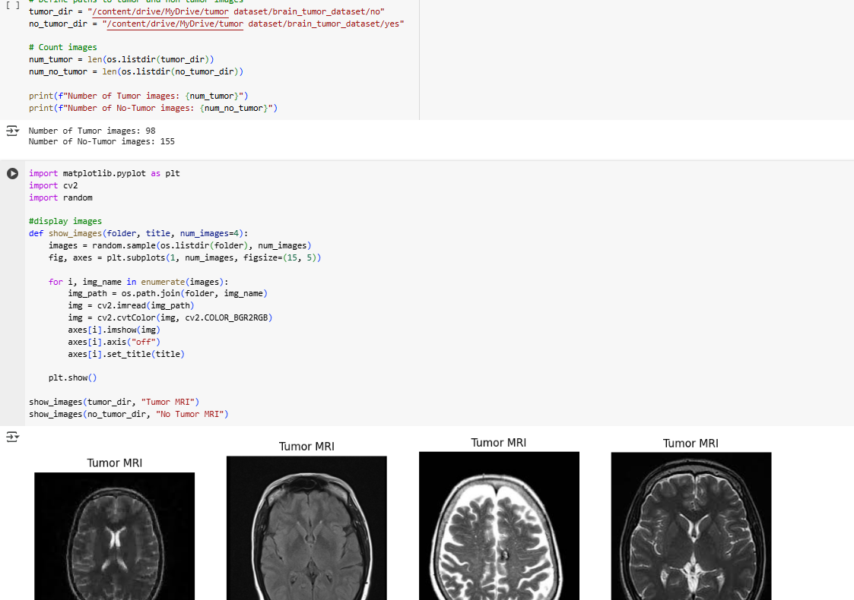
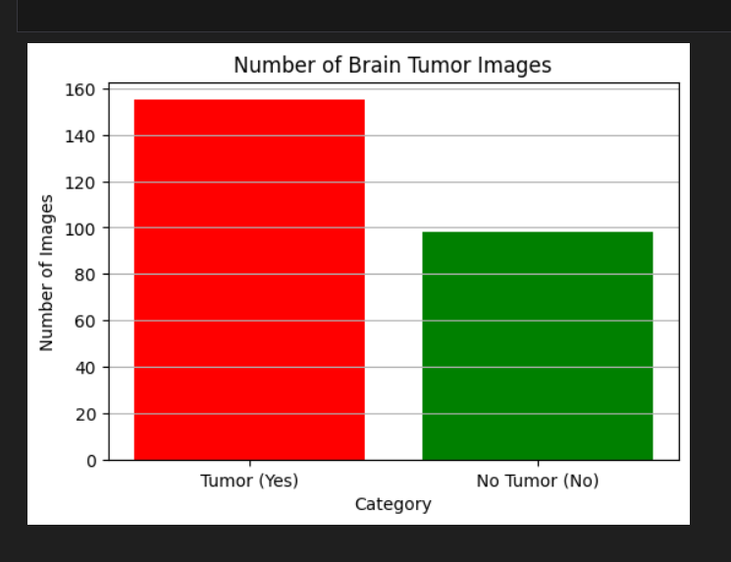

Slide 10
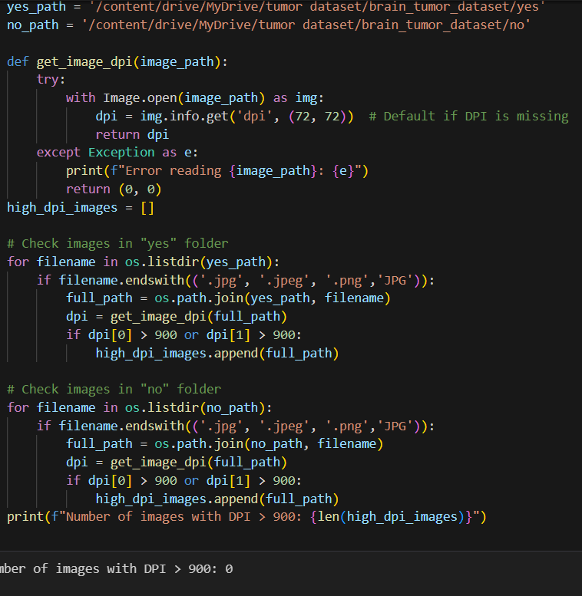
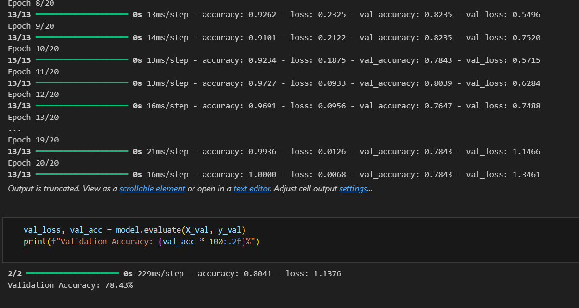

Slide 11
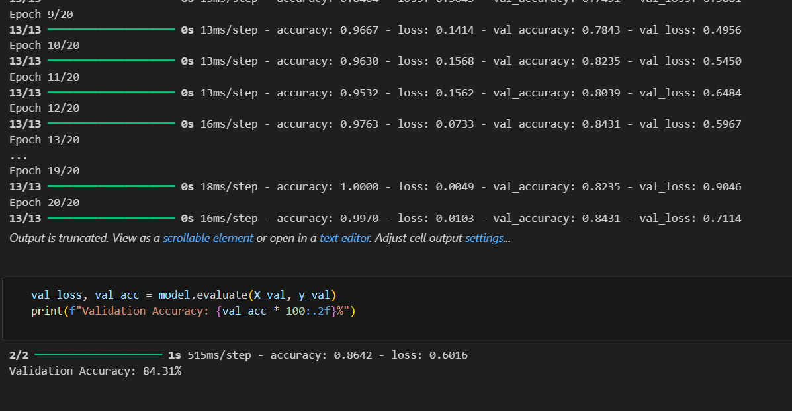
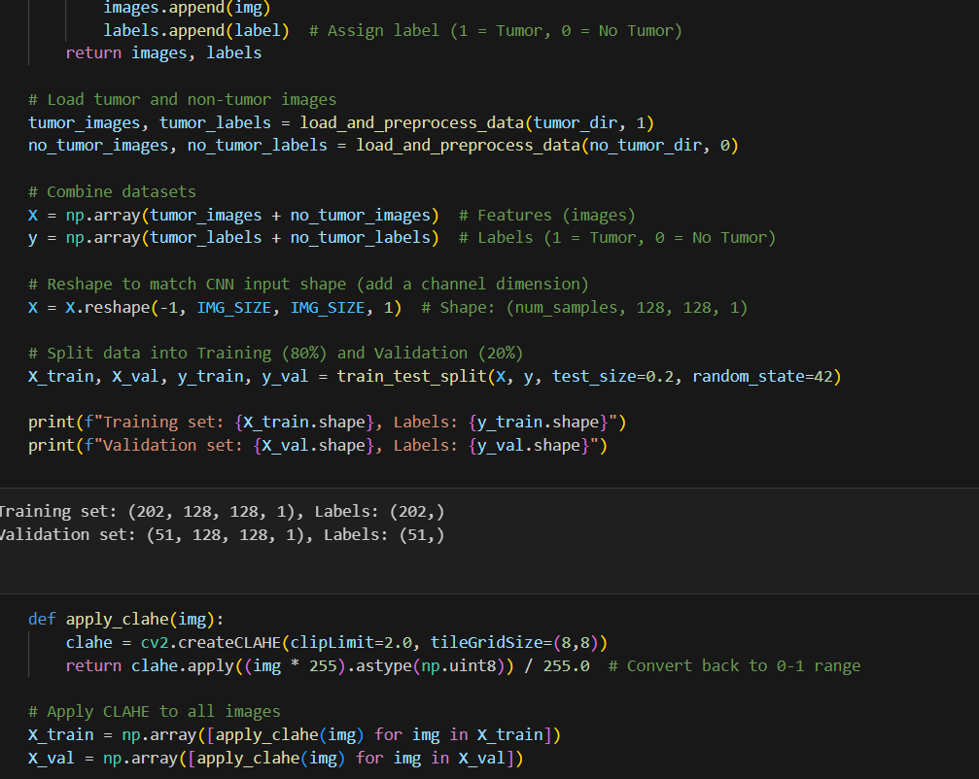
After applying this function which basically cancels noise.

Slide 12
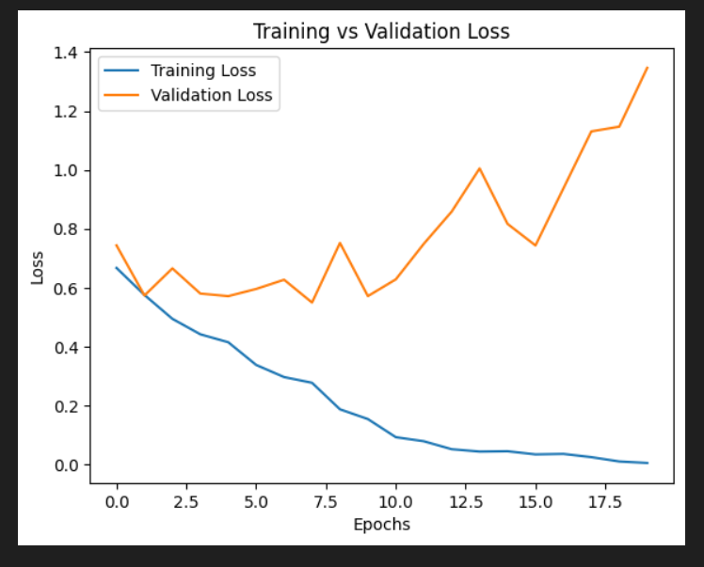
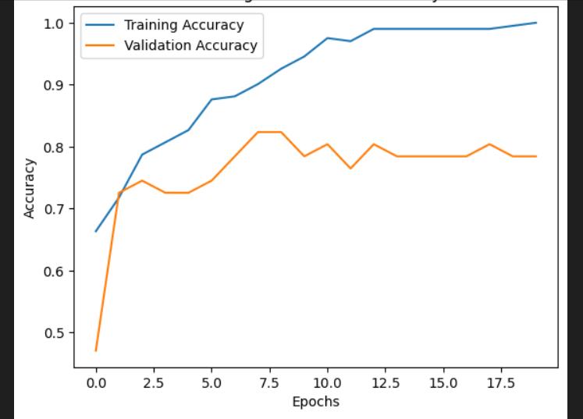
Previous graph:

Slide 13
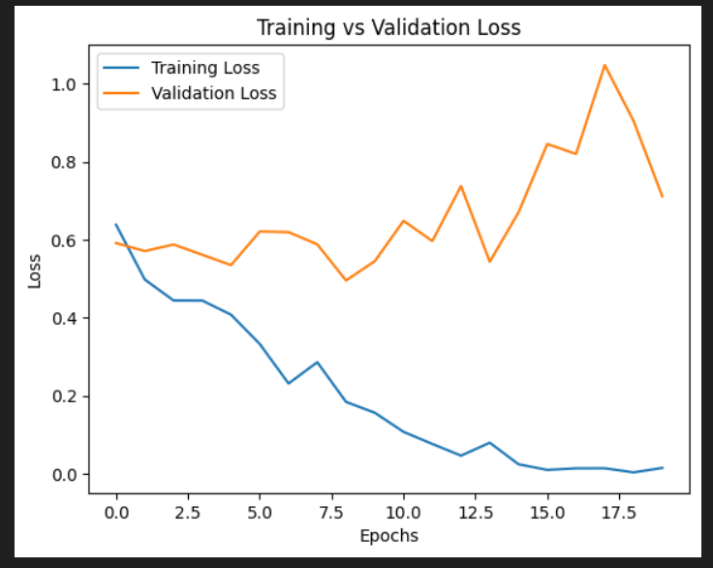
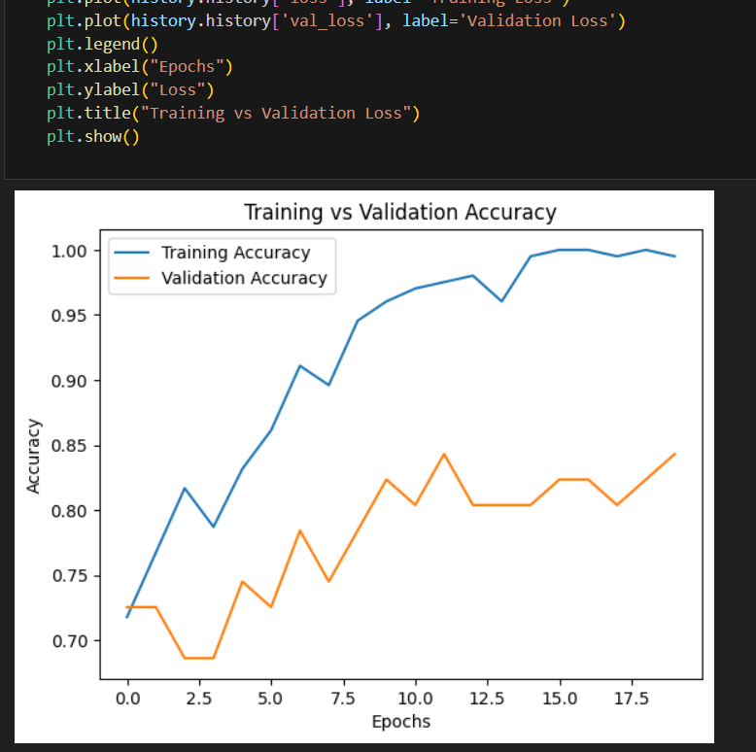
Final Graph

Slide 14
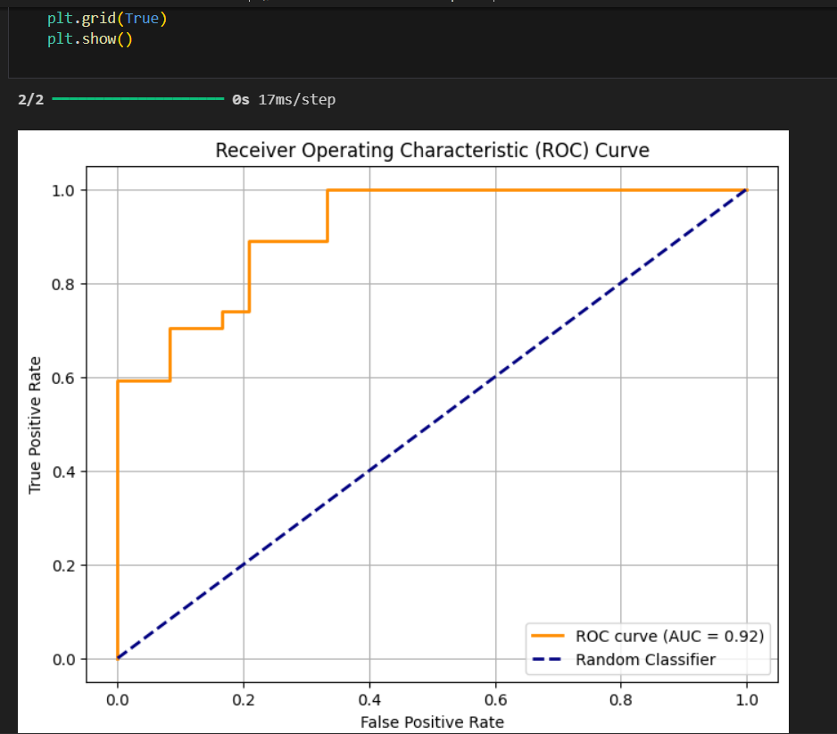
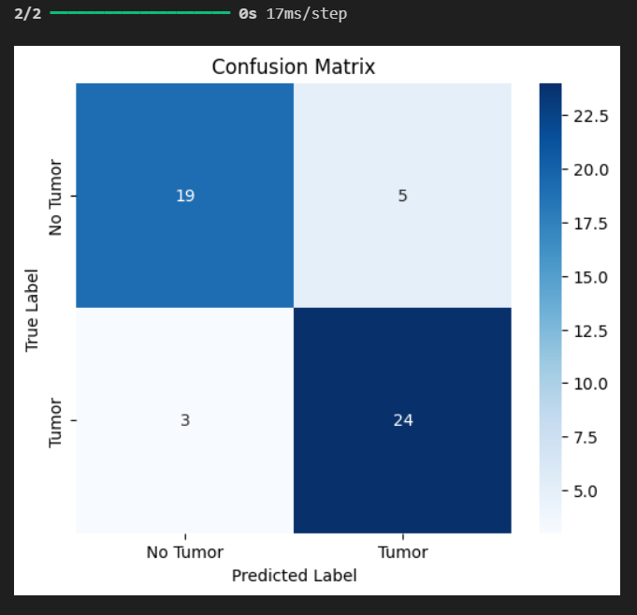
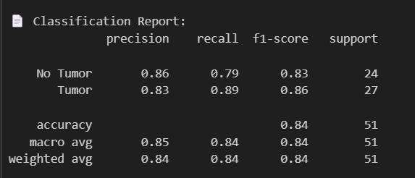

Slide 15
Conclusion:
1) With Deep Learning models we can make predictions quickly but we still need to process the dataset and learn more about the mathematical application to make the prediction more accurate and understand deeply.
2) Not only CNN, we should also try to implement this with different type of models (like YOLO) to learn and analyze more.
3) Even the model is complex a simple user interface can be done for immediate and efficient detection.
4) Various techniques like dropout, data augmentation can be done for increasing accuracy and to avoid overfitting issues. In the next slide I will also provide some possible augmentation results for an idea.

Slide 16
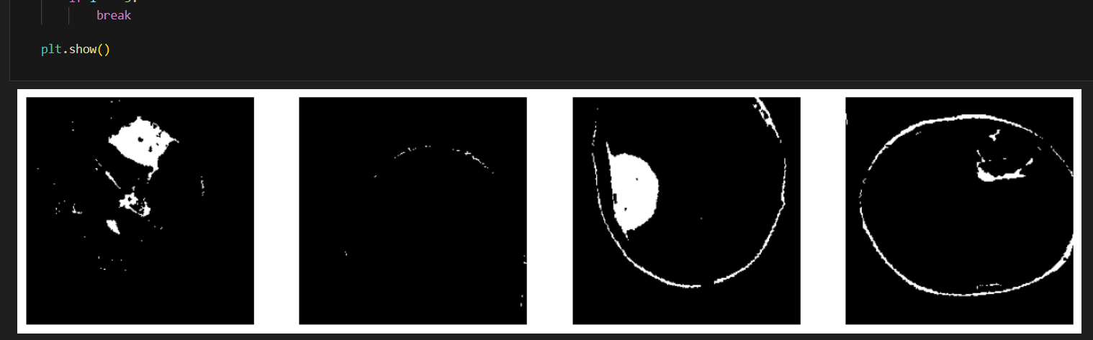
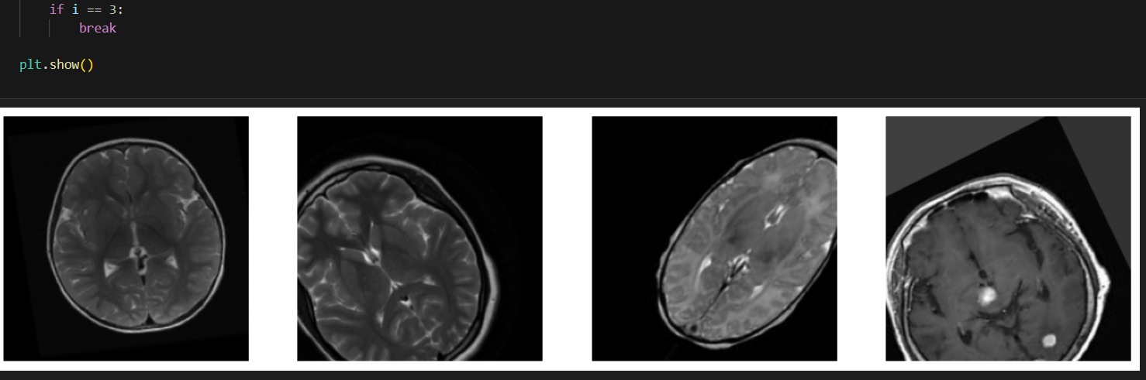

Slide 17
~ Thank you ☺

